Slide 1
AI Fundamentals for Healthcare
Session 3 of 4 — Deep Learning and Generative AI
March 13, 2026
Vancouver Marriott Pinnacle Downtown Hotel
cair.ca

Slide 2
Where We Got To
Session 1: what a model is, and how training works.
Session 2: the classical model families, the data they need, and how to judge them.
Today:
  Deep learning, and why it changed what is possible with images, signals and text
  Large language models, what they do and what they cannot do
  What it takes to put any of this into clinical practice without causing harm
The last part is the shortest in slides and the longest in calendar time.
Notes:
Thirty seconds, no more. The purpose is to orient anyone who missed the previous session, not to re-teach it.

Slide 3
Comparison of Classical Machine Learning and Deep Learning
Classical Machine Learning
Deep Learning
Readmission risk - Predicting 30-day readmission from admission vitals
Length of stay prediction - Forecasting bed capacity and discharge timing
Demand forecasting - Short-term emergency department volume
Anomaly detection - Identifying anomalous telemetry or claims
Early warning scores - Threshold-based deterioration alerts
Cost modelling - Understanding cost drivers per episode
Radiology image analysis - Detecting pathology on X-ray and CT
Digital pathology - Tumour detection and grading from slides
Clinical language models - Summarising notes and drafting documentation
Continuous monitoring - Detecting falls and patient deterioration on video
Retinal screening - Grading diabetic retinopathy from fundus images
ECG rhythm classification - Distinguishing arrhythmias from normal sinus rhythm

Slide 4
Deep Learning
Deep learning involves deeply layered neural network models (DNNs).
These models are very capable and excellent learners.
They learn using gradient descent to minimize their loss function.
Because they are so good at learning patterns, they are the central component of most Artificial Intelligence systems.
DNNs can self-learn hierarchical relationships.
This means that if they have the basic data as inputs, they can figure out complex meaning and relationships themselves.
For example, they could be given chest X-rays and learn to identify pneumonia.
Or they could be given ECG waveforms and learn to identify arrhythmias. Both examples require labelled data for training, but the model will figure out the important features on its own.

Slide 5
Convolutional Neural Networks (CNN)
Convolutional Neural Networks (CNNs) are a type of neural network designed specifically for processing grid-like data such as image data.
They use convolutions, which involve small filters sliding across the input, detecting patterns like edges and combining them into increasingly complex features in deeper layers.
This design can learn spatial hierarchies, making them useful for visual tasks.

Slide 6
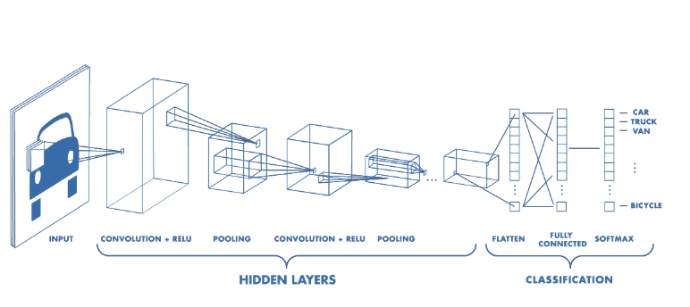
Convolutional Neural Networks (CNN)
Convolutional Neural Networks – Automatic Feature Determination
https://www.mathworks.com/videos/introduction-to-deep-learning-what-are-convolutional-neural-networks--1489512765771.html

Slide 7
Recurrent Neural Networks (RNN)
When processing a sequence of tokens there is the challenge of knowing the context in which a given input is received.
A Recurrent Neural Network (RNN) is one approach to this issue.
The hidden state (memory) from one step is passed as input to the next.
Although this does add context information, it suffers from gradual diminished information (vanishing gradient).

Slide 8
Long
Short-Term Memory Networks (LSTMs)
LSTM networks add the ability to influence the output with contributions from both long and short term memory
They can pass on state and independently determine how much of it influences the output
Thus, they can learn both long and short term dependencies

Slide 9
Auto-Encoders
Input Layer (features)
Output Layer (target)
Hidden Layers

Slide 10
Artificial Intelligence
Machine Learning
Neural Networks
Deep Learning
Transformer
LLM

Slide 11
Large Language Models
Type of Artificial Intelligence model
Typically trained using a broad range of text
“Understand” and Generate human language (predict next word)
Very large – billions of parameters
  Often does not require task specific learning

Slide 12
Word Embeddings
Words (tokens) are encoded as a list of numbers (embedding)
The values are determined by training a relatively simple neural network
Words with similar meaning tend to have similar values (adjacent)
Pairs of words with similar differences tend to have the same differences in their values

Slide 13
Simple Word Embedding

Slide 14
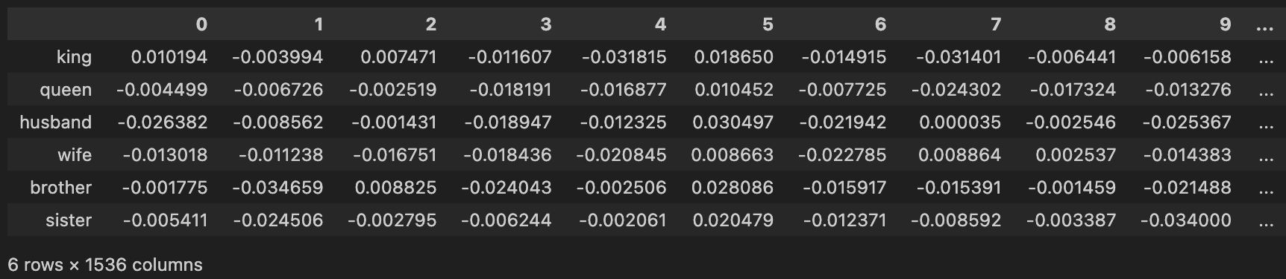
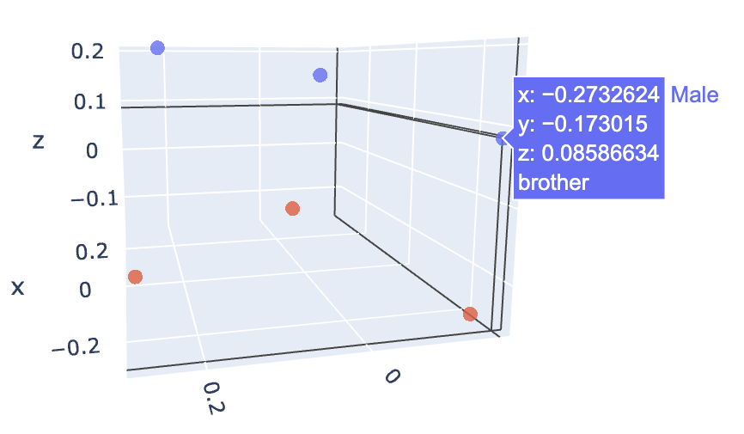
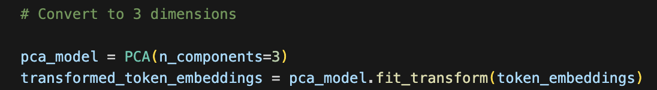
Large Language Model Word Embeddings

Slide 15
LLM – Predicting the next most probable word (token)
After he put on his shirt, he put on his…
91.2%
pants
6.3%
tie
5.7%
jacket

Slide 16
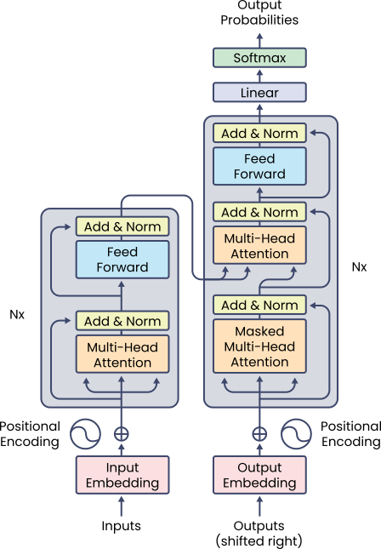
Transformers
Multiple layers of neural networks
Ex. Transformer networks
Example use cases
Image recognition
Translation
Classification
Attention is all you need
NIPS'17: Proceedings of the 31st International Conference on Neural Information Processing Systems
December 2017 Pages 6000–6010
Figure 1 : The Transformer – model architecture.

Slide 17
The meaning of a token depends on the context.
Due to a shortage of staff, a patient seeking healthcare must be patient.
A transformer model can pay attention to other tokens

Slide 18
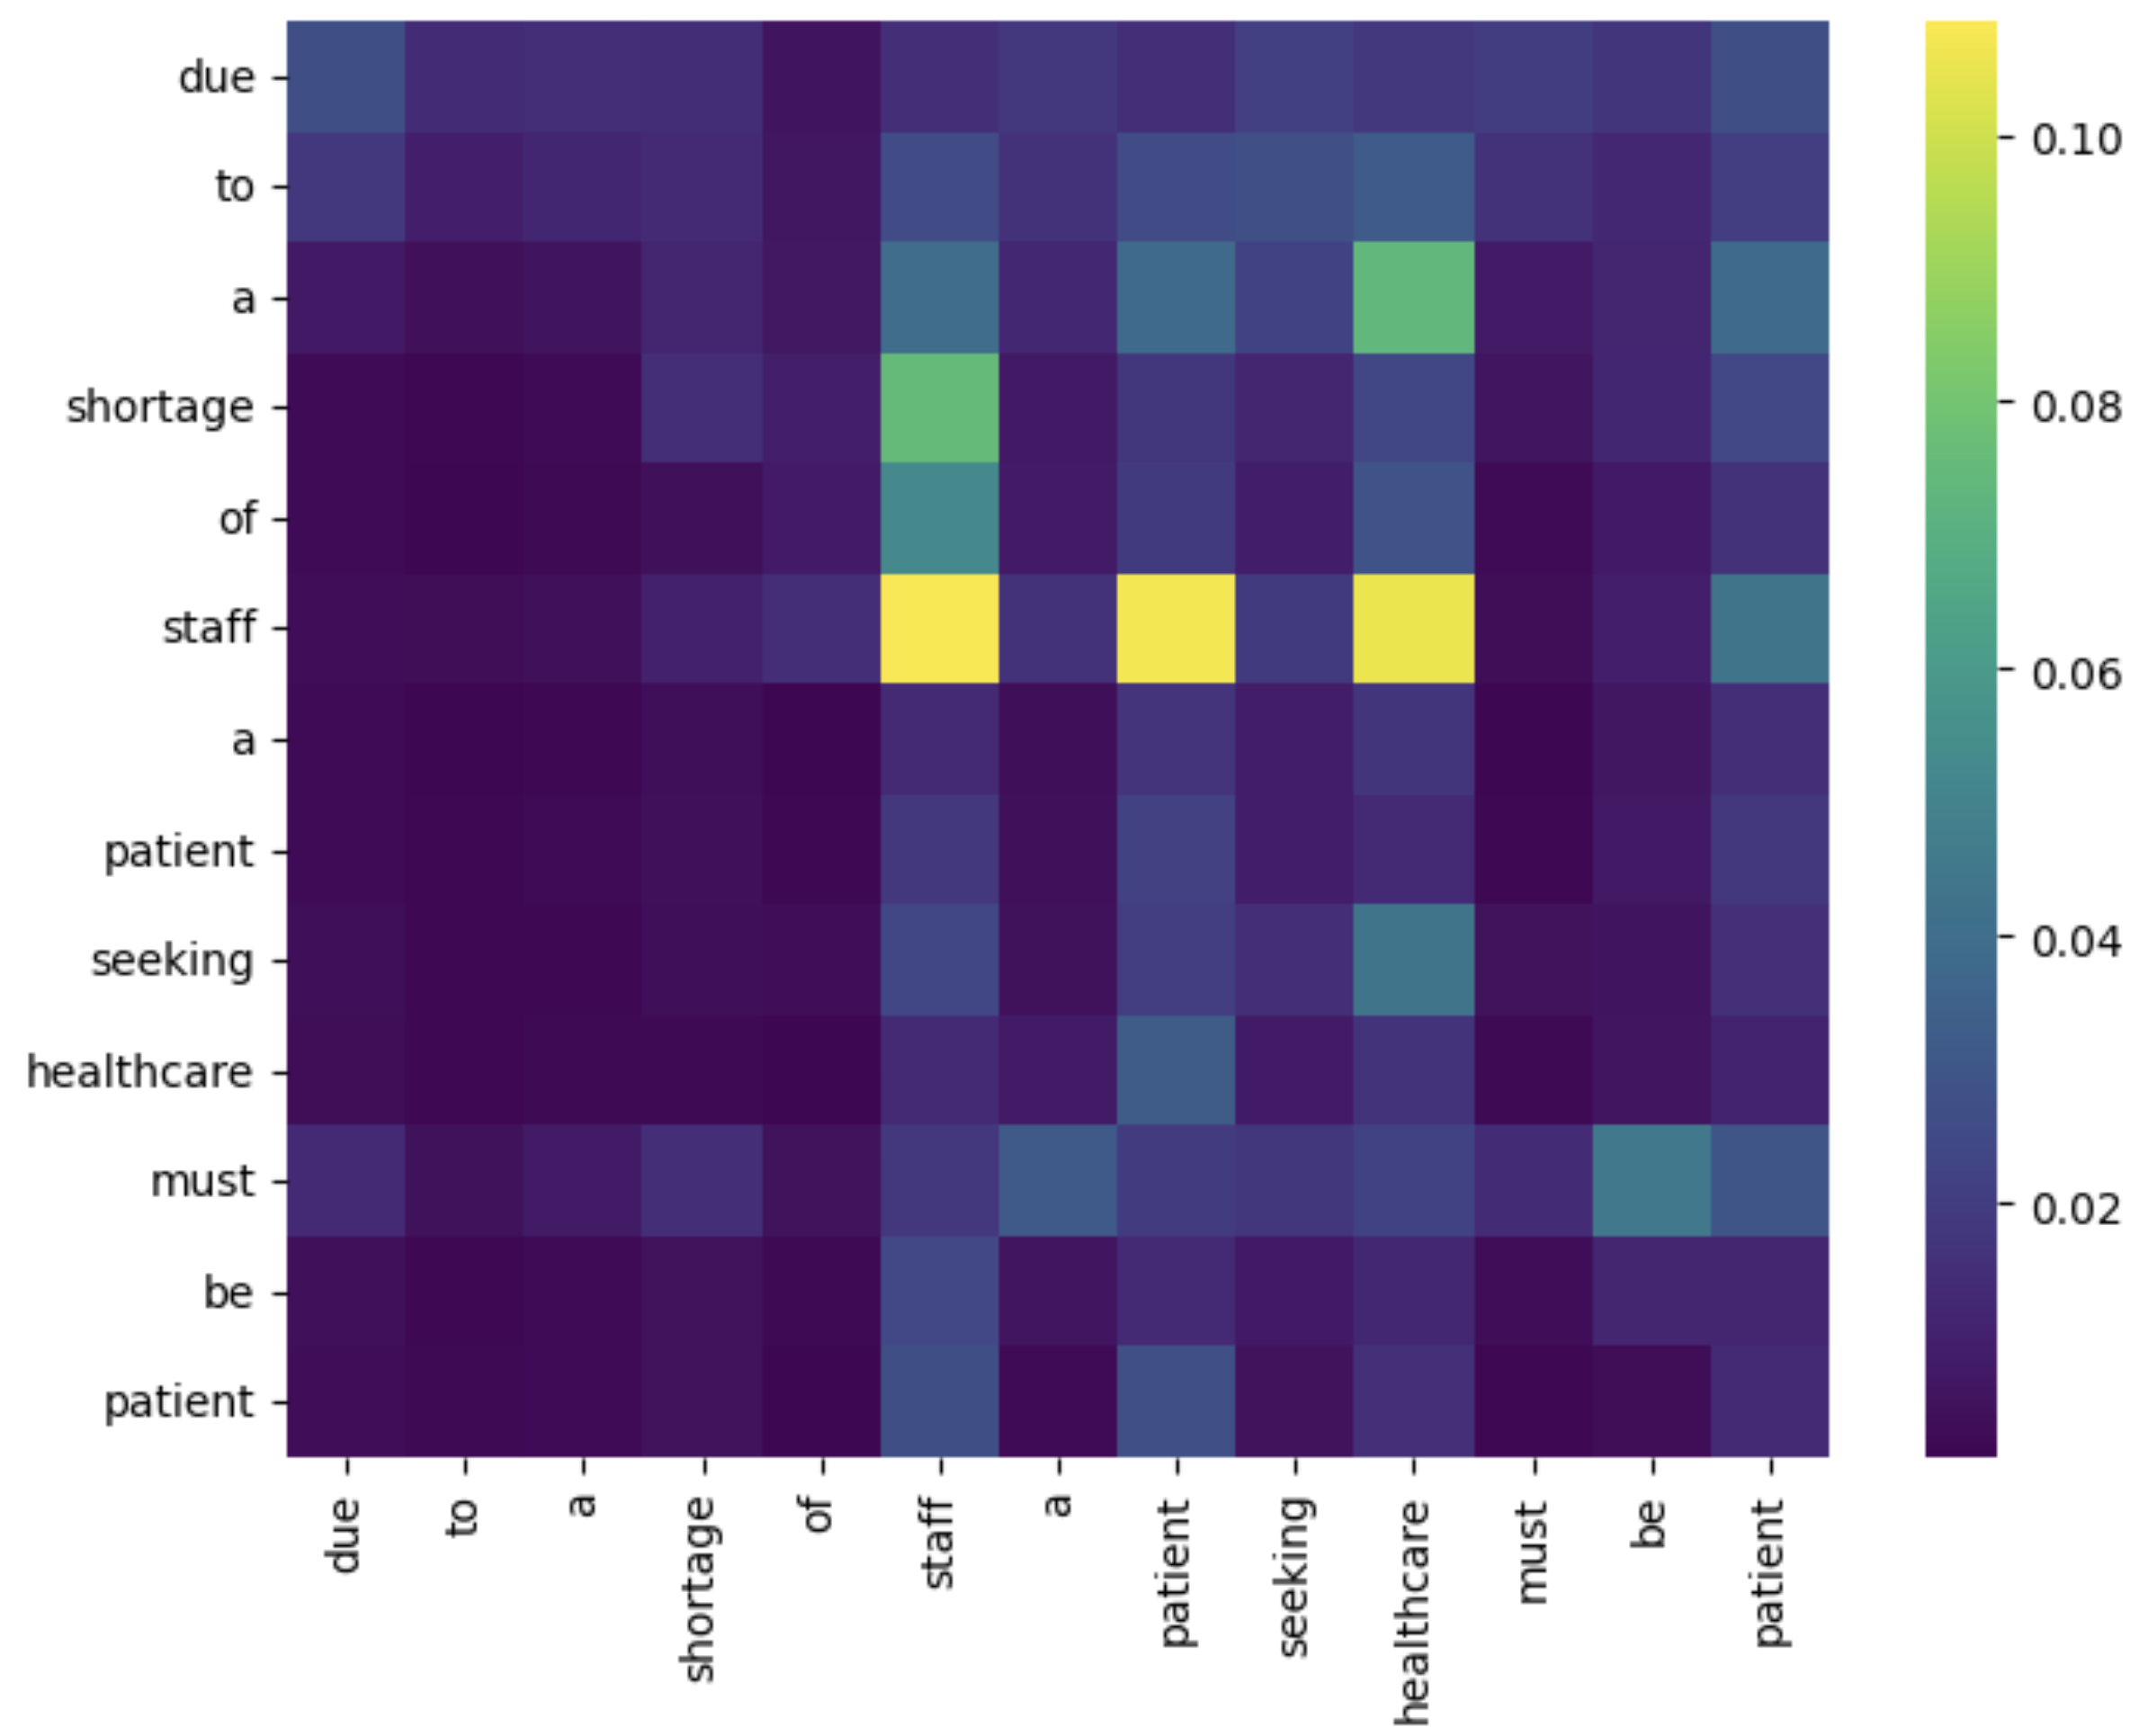
Self Attention

Slide 19
Customizing Responses
Model
Context
  Fine-tuning
    Train the model using the custom data
    Only a portion of the model parameters may require fine-tuning
  Prompting
    Provide a detailed request (zero shot)
    Provide an example questions and answers (n shot)
  Retrieval Augmented Generation (RAG)
    Query a database to retrieve information to include in the request
  Tool use - Model Context Protocol (MCP)
    Call a tool to obtain information or perform an action

Slide 20
Where Language Models Are Actually Being Used
Working today
Not ready, or needs great care
Ambient documentation: drafting the note from the consultation, clinician edits and signs
Drafting replies to patient portal messages for review
Coding and billing support
Summarising a long record for handover
Literature search and synthesis
Autonomous diagnosis or triage
Any output acted on without review
Treating the record as fact rather than as text somebody wrote
Patient-facing advice with no clinician in the loop
Anything where being confidently wrong is not immediately visible
Notes:
Audiences arrive with wildly different assumptions about this, from 'it will replace radiologists' to 'it is a toy'. The two columns are there to reset both.
Ambient documentation is the example most likely to be in your own organisation already. Ask whether anyone is using one.
About 5 minutes.

Slide 21
The Pattern in What Works
Look at what succeeds and what does not, and one distinction does most of the work:
A human reviews every output, and the cost of an error is a correction rather than harm.
Ambient documentation works because the clinician reads and signs the note. The model saves typing, not judgement.
Autonomous triage fails the same test. Nobody sees the error until it has already reached the patient.
When assessing any proposed use, ask: who reads this before it matters, and what happens when it is wrong?
Notes:
This is the analytical payoff of the previous slide. The distinction is worth stating as a rule they can apply to any proposal that crosses their desk.
About 3 minutes.

Slide 22
Large Language Models
Can “hallucinate” – generate sensible but incorrect information
Can generate biased content and harmful content
Can affect critical thinking
Privacy concerns
Right to use training data
Relatively expensive computation

Slide 23
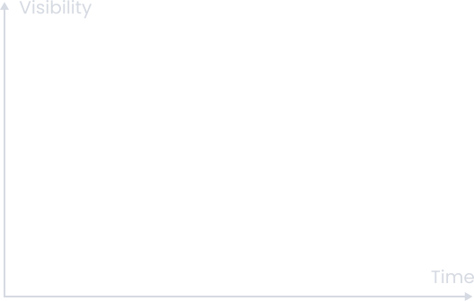
Peak of Inflated Expectations
https://en.wikipedia.org/wiki/Gartner_hype_cycle

Slide 24
Data Pipelines
Data Collection
Preprocessing
  Conversion to/from categorical and continuous data
  Scaling
Labelling and Annotation
Splitting
  Training
    Validating
  Testing

Slide 25
Aggregation of Data Silos
Data Lake
(as-is copies)
Pharmacy
Medical
Theatre Operations
Device
Clinic
Operations
Hospital Systems
Data Warehouse
(organized for analysis)
Population Health View
Bedside Devices
Scheduling

Slide 26
Analytic Data Model
Entities (things)
  Patients
  Devices
  Clinics
Events
  Sensor readings
  Transfers
  Adverse events

Slide 27
Entity and Event Profiles
Profile data includes basic, calculated and aggregated features
These feature values are used to train the model to predict the target value
Also used at inference time to obtain the target value

Slide 28
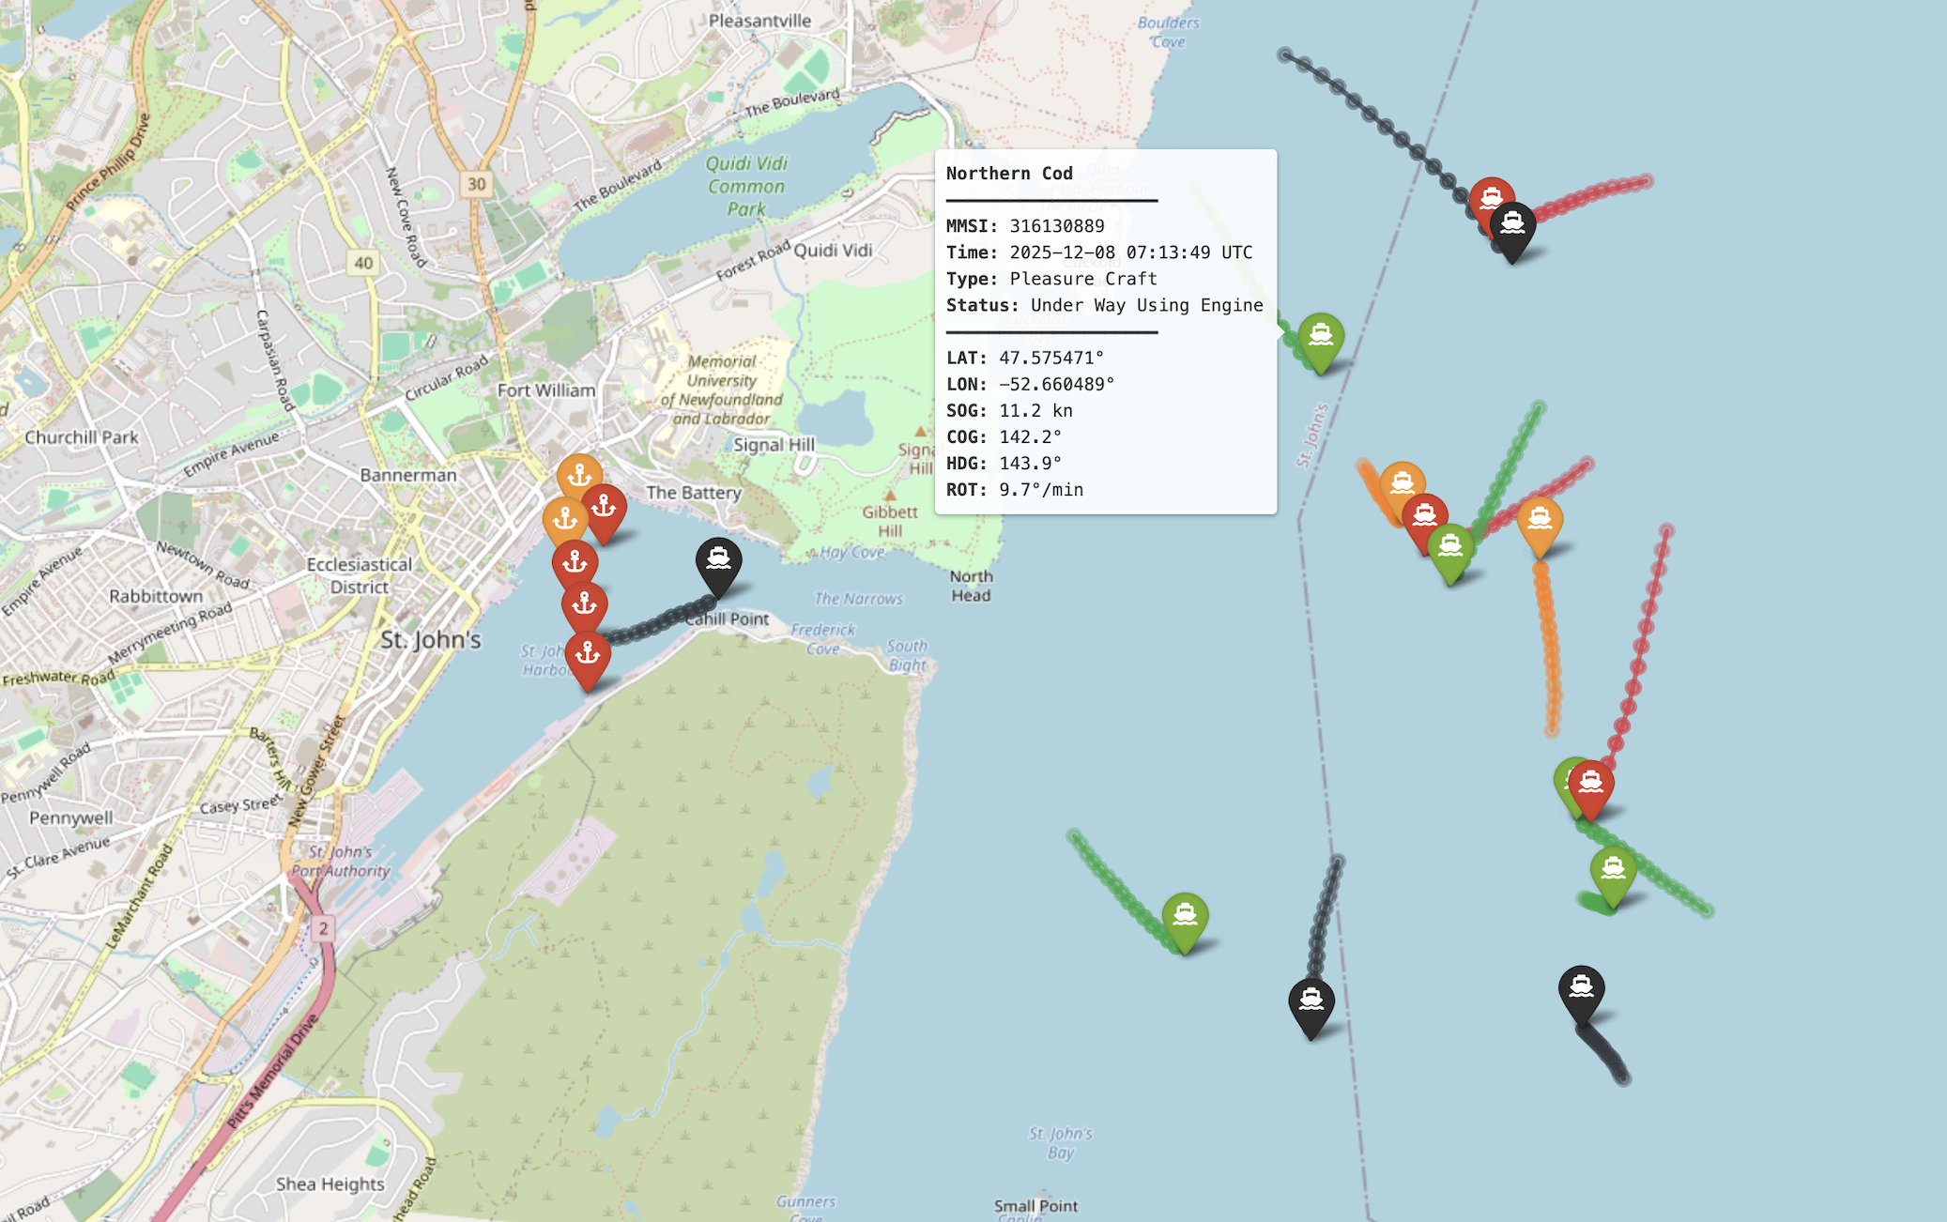
HL7 FHIR (Health Level 7 Fast Healthcare Interoperability Resources)

Slide 29
Explainability
Because of the complexity of many machine learning models, it is not possible to explain why they produce the output that they do other than to say it is based on the patterns they learned in the training data.
This is an inherent weakness in establishing trustworthiness and credibility of many machine learning models.
As stated earlier we turn to machine learning when we have examples, but we don’t know how to obtain the behavior we need using explicit instructions.
We instead use the examples to train (adjust the parameters of) a model that is then able to perform the desired behavior.
In some cases of relatively simple models with few parameters (ex. Linear regression) we can interpret the meaning of the parameter values.
But in general, for most models such as deep neural networks, we cannot explain model behavior based on parameter values.

Slide 30
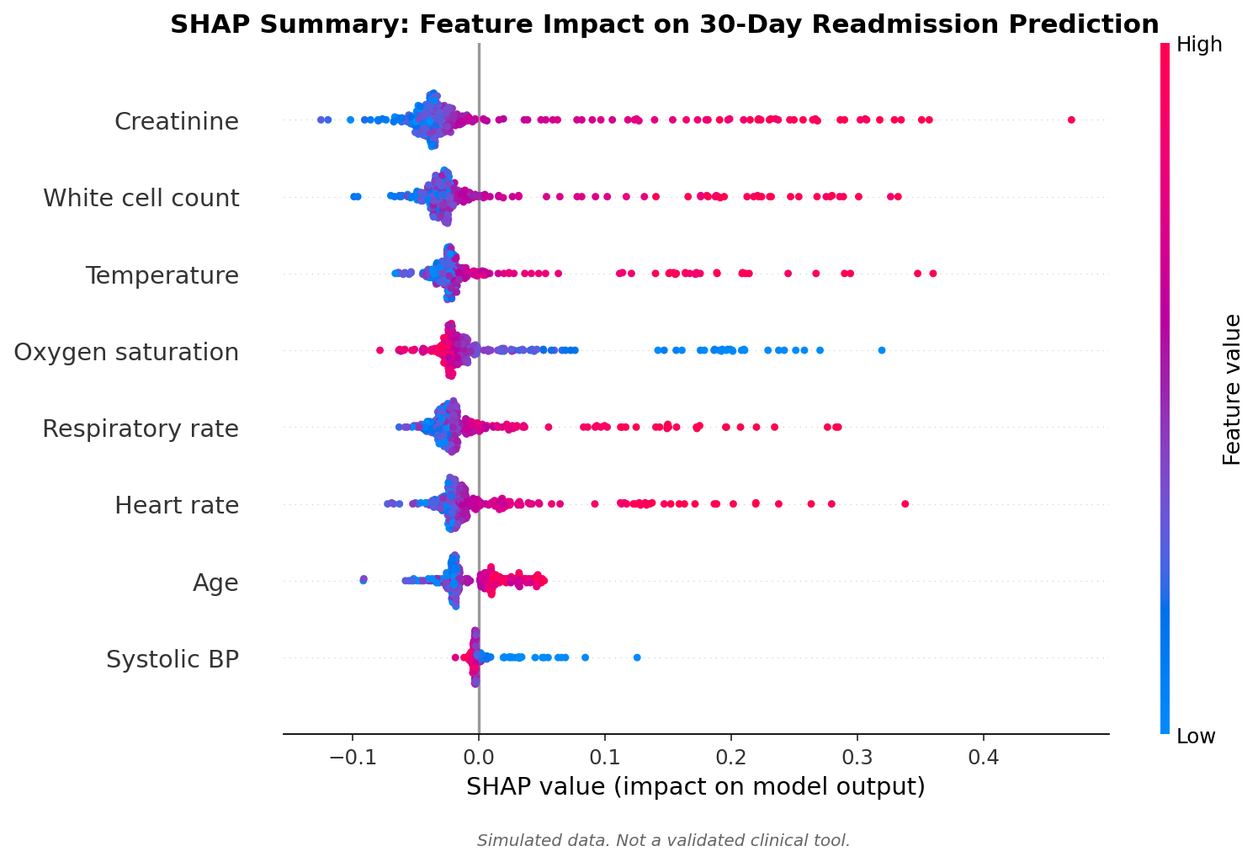
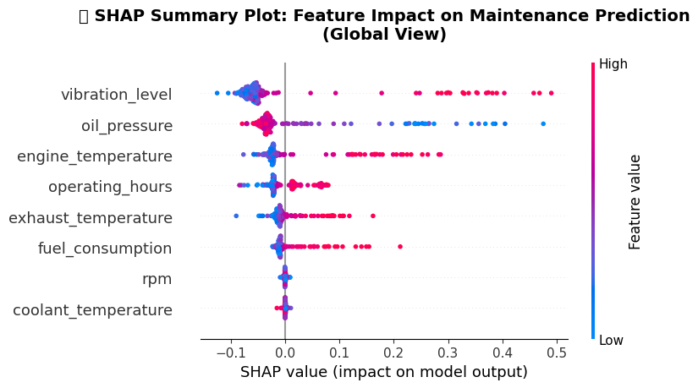
Explainability – SHAP Values
SHAP Summary Plot: Feature Impact on Readmission Prediction (Global View)

Slide 31
Drift
Models in production may tend to slowly decrease in performance
There are likely one or more features whose values have changed (drifted) from when the model was trained
The model may need to be to periodically retrained to correct its parameters and restore its performance

Slide 32
When a Model Becomes a Medical Device
Software that informs a clinical decision may be a regulated medical device, usually described as Software as a Medical Device.
Health Canada and the FDA both regulate on this basis. Risk class depends on how serious the condition is and how much weight the software carries in the decision.
A tool that supports a clinician who can independently review its basis is treated differently from one that drives the decision.
A locked model and a model that keeps learning after deployment are treated very differently. Continuous learning raises the bar considerably.
Internal quality-improvement use follows a different path from a commercial product. It is not an exemption from governance.
Decide this early. The pathway determines what evidence you must collect, and it is expensive to reconstruct afterwards.
Notes:
Keep this factual and do not give regulatory advice. The goal is that nobody in the room is surprised later to learn their project may be building a medical device.
The locked versus continuously learning distinction is the one people have usually never considered, and it has real design consequences.
About 5 minutes.

Slide 33
A Model That Is Ignored Has No Value
Alert fatigue is the most common way a technically sound model delivers nothing. Clinicians learn to dismiss alerts that are usually wrong.
Automation bias is the opposite failure: a confident score displaces clinical judgement, most often with junior staff at night.
Both are design problems, not user problems.
Questions to settle before launch:
  Where does the output appear, and who is accountable for acting on it?
  What is the expected action, and how long should it take?
  What happens when it is wrong in each direction, and who notices?
Measure the intervention, not the prediction. Alerts acted on, time to treatment, outcome.
Notes:
Clinical audiences will have lived this. Ask how many alerts they dismissed on their last shift without reading them. The answer makes the argument for you.
Both failure modes are design problems. Resist any framing that blames users.
About 6 minutes including discussion.

Slide 34
Before You Deploy: A Checklist
Evidence
Operations
External validation on your own population
Calibration checked locally, not inherited
Performance reported by subgroup
Prospective silent run completed
Failure modes documented in both directions
A named clinical owner
A defined action for each output
Monitoring for drift and for alert burden
A route to switch it off, and someone empowered to use it
Privacy and information governance review
A documented decision on regulatory status
Notes:
Offer this as something to take away rather than something to read aloud. Walk the two column headings and stop.
The item people skip is the last one on the right. Deciding regulatory status late is expensive.
About 3 minutes.

Slide 35
Change Management
Identify areas to demonstrate value
Prove safety and effectiveness
Close monitoring, human in the loop
Gradual increase in capability
Increase user productivity
Support critical thinking

Slide 36
Where to Go Next
The notebooks accompanying this series cover every model we discussed, with runnable code and simulated clinical data.
Start with a problem where you already hold the data and there is a clear decision that could change.
Prove value in a silent run before anyone relies on the output.
Build the monitoring before the model, not after it.
Worth reading:
TRIPOD+AI (2024), for what a clinical prediction model should report
Obermeyer et al., Science 2019, on how a proxy label encodes inequity
Your own institution's AI governance policy, which probably exists and is probably unread
Session 4 takes the next step: what changes when a model stops predicting and starts acting.
The hardest part is rarely the model.
Notes:
Close on the last line and let it sit. The hardest part is rarely the model.
Point at the notebooks concretely, and name one that suits this particular audience.
About 3 minutes.

Slide 37

Questions?

